Slide 1



Toxicity Potential of Thin-Film Solar Panels in Municipal Waste Landfills
Jeannie Wilkening
Reyes Sierra, Jim A. Field, and Adriana Ramos-Ruiz
Chemical and Environmental Engineering Department
University of Arizona
Arizona Space Grant Consortium Symposium
April 12, 2014

Slide 2

Background
Huge increases in global solar photovoltaic capacity in recent years
Use of thin-film photovoltaics is growing
Uncertainty regarding disposal
Image courtesy Mike Baker
Notes:
-Global PV capacity in 2012 was nearly 100 times what it was in 2000 (REN21 Renewables 2013 Global Status Report)
-Thin-film solar cells are predicted to become the dominant type of photovoltaics in the coming decades
-lower efficiency than more traditional silicon PVs, but are cheaper to produce
-CdTe most popular thin-film technology
-2011: 8% of total PV production and continuing to grow (Fraunhofer institute for solar energy systems ISE, Photovoltaics report, Dec 2012)
-warranties typically 20-25 years, approaching real first wave of solar disposal
-no real regulations in US currently
-EU regulates that majority must be recycled

Slide 3
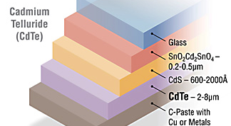
CdTe Thin-Film Photovoltaics
Cadmium (Cd)
  Serious health effects
  Maximum contaminant level (MCL) = .005 mg/L
  Toxicity characteristic leaching procedure (TCLP) limit= 1 mg/L
Tellurium (Te)
  Rare and valuable
  Not regulated by Environmental Protection Agency (EPA)
Photo Credit: National Renewable Energy Laboratory
Notes:
-Cadmium → kidney and lung damage, suspected carcinogen
-Tellurium very rare and valuable

Slide 4
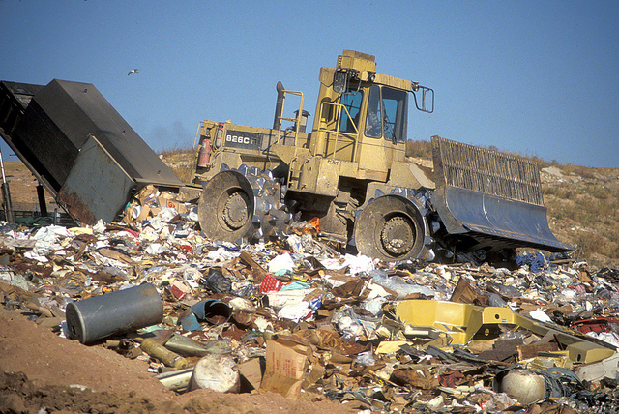
Objectives
Do CdTe thin-film photovoltaics pose a toxicity hazard under municipal landfill conditions?
Are the risks different under different landfill conditions?
Image courtesy Wisconsin Department of Natural Resources

Slide 5
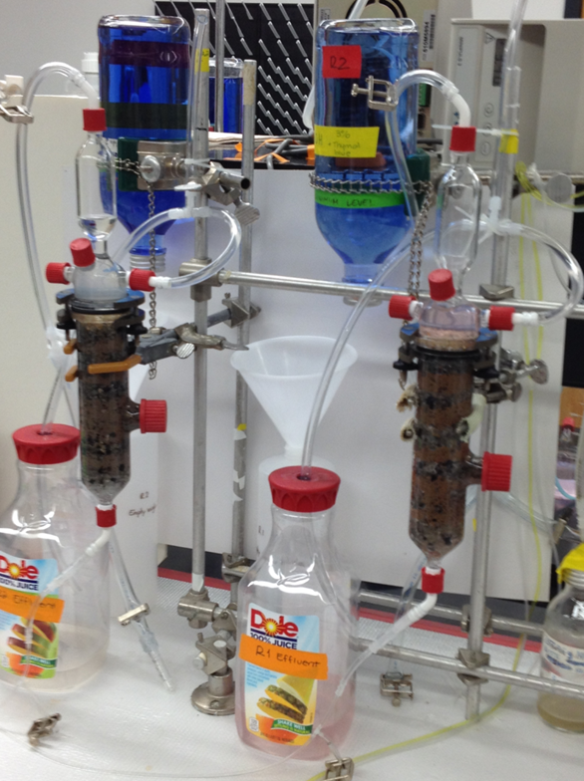
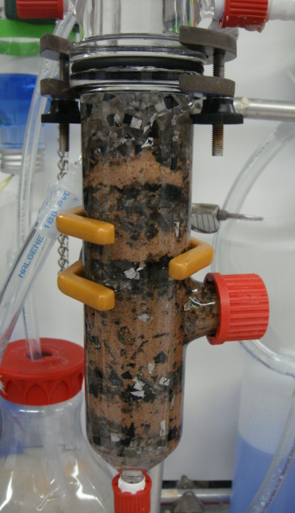
Methods
Set up two anaerobic reactors
  pH 7 and pH 5
Effluent collected periodically over 2 months
Used inductively coupled plasma optical emission spectrometry (ICP) to measure levels of tellurium and cadmium
Images courtesy Adriana Ramos-Ruiz

Slide 6
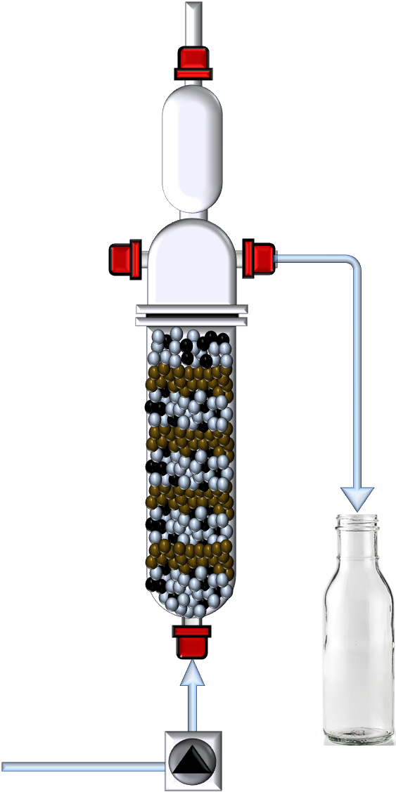
Reactor Set-Up
Reactor Contents:
-Anaerobic sludge
-Solar film and glass
Gas:
-CH₄
-CO₂
Effluent:
-VFAs
-Inorganic ions
-Dissolved Cd and Te
Influent:
-Volatile fatty acids (VFA)
-Inorganic ions
Diagram courtesy Adriana Ramos-Ruiz

Slide 7
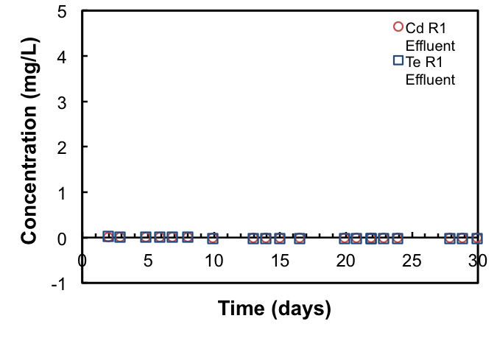
Release of Cd and Te from Reactor 1 (pH 7)
Most of Cd and Te were retained at pH 6.7

Slide 8
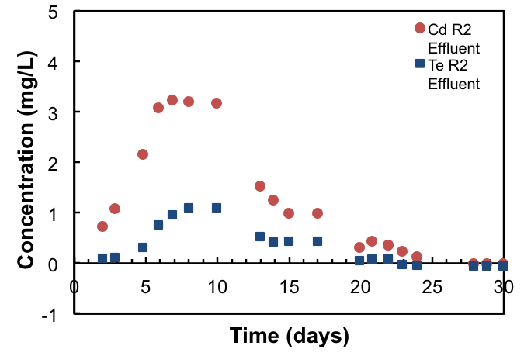
Release of Cd and Te from Reactor 2 (pH 5)
TCLP = 1 mg/L Cd
MCL =.005 mg/L Cd
Significant release of Cd and Te over first 25 days

Slide 9
Conclusions
Acidic landfill conditions can lead to unhealthy levels of cadmium release
  Most of release during first month
  Maximum Cd level in effluent = 3.2 mg/L
    Exceeds both TCLP and MCL levels
Less risk under neutral conditions
Regulations for disposal of CdTe solar cells are needed

Slide 10
Acknowledgements
UA/NASA Space Grant Program
Adriana Ramos-Ruiz
Dr. Reyes Sierra
Dr. Jim Field

